Slide 1



Group 2
Barplot
descriptive
Group 3
csv

Slide 2
box_plot
Distance_Statistical
csv
distance_curve

Slide 3
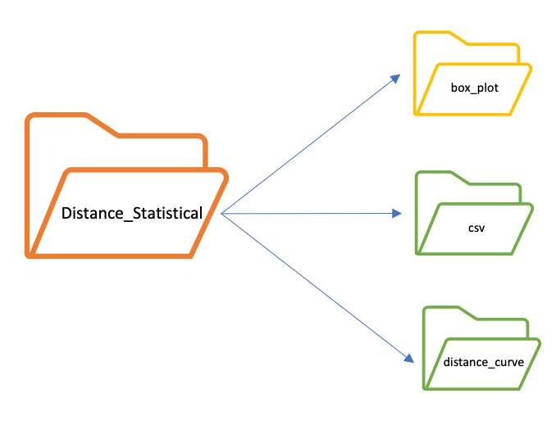

Slide 4

Group 2
descriptive
Group 3
Boxplot

Slide 5
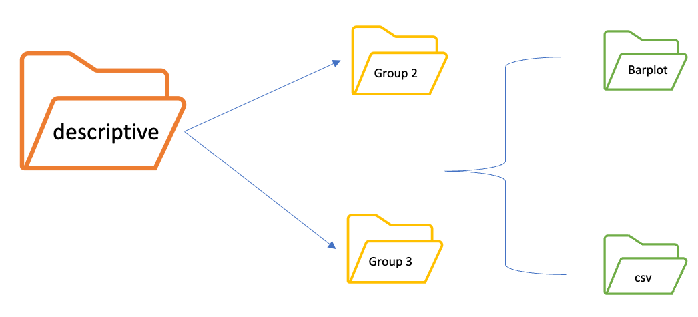

Slide 6
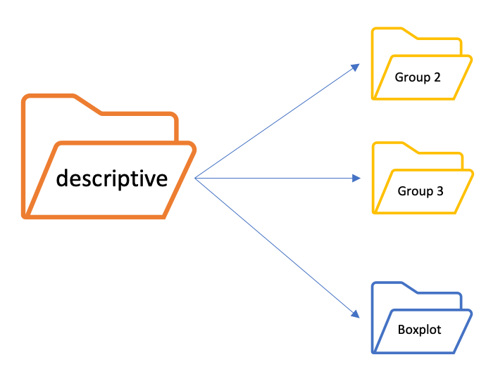

Slide 7
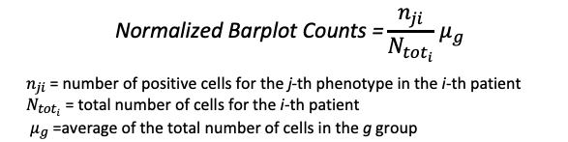

Slide 8
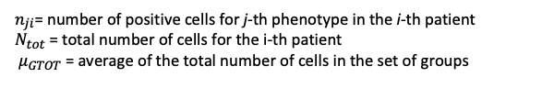

$$\text{Normalized} \text{Boxplot} \text{Counts}=\frac{n_{ji}}{N_{tot}}{ μ}_{Gtot}$$
$n_{ji}$= number of positive cells for j-th phenotype in the i-th patient
$N_{tot}$ = total number of cells for the i-th patient
${ μ}_{GTOT}$ = average of the total number of cells in the set of groups

Slide 9
